Slide 1
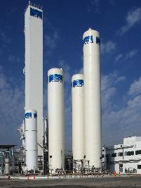
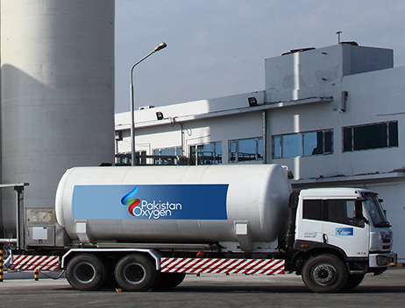
Pakistan Oxygen Limited
(formerly Linde Pakistan Limited)
Analyst Briefing
Leveraging Our Strengths
To
Innovate And Grow

Slide 2
Disclaimer
THIS PRESENTATION IS NOT AN OFFER OR SOLICITATION OF AN OFFER TO BUY OR SELL ANY SECURITIES OR ANY INVESTMENT.
This presentation has been prepared by Pakistan Oxygen Limited solely for information purposes. Therefore, no representation or warranty express or implied is made thereto, and no reliance should be placed on , the fairness, accuracy, sufficiency, completeness or correctness of the information or any opinion contain herein or any opinion rendered thereto, the information contained in this presentation should be considered in the context of the circumstances prevailing at the time and will not be updated to reflect any developments that may occur after the date of presentation. Neither Pakistan Oxygen Limited nor any of its respective officials, associates, employees or any person working under or on behalf of, have any responsibility and/or liability of any nature whatsoever for any loss arising from any use of the information give here.
This presentation does not constitute or form part of prospectus, offering circular or memorandum or an offer, solicitation, invitation or recommendation to purchase or subscribe for any securities and no part of it shall form basis of, or be relied upon in connection with, or act as any inducement to enter into any arrangement, agreement, contract, commitment or investment decision in relation to any security.
You agree to keep the contents of this presentation strictly confidential. All or any part of this presentation may not be taken away, reproduced, copied, redistributed retransmitted or disclosed in any manner or form and for any purpose whatsoever.
By attending this presentation, you are agreeing to be bound by the foregoing limitations.

Slide 3

Our Heritage

Slide 4

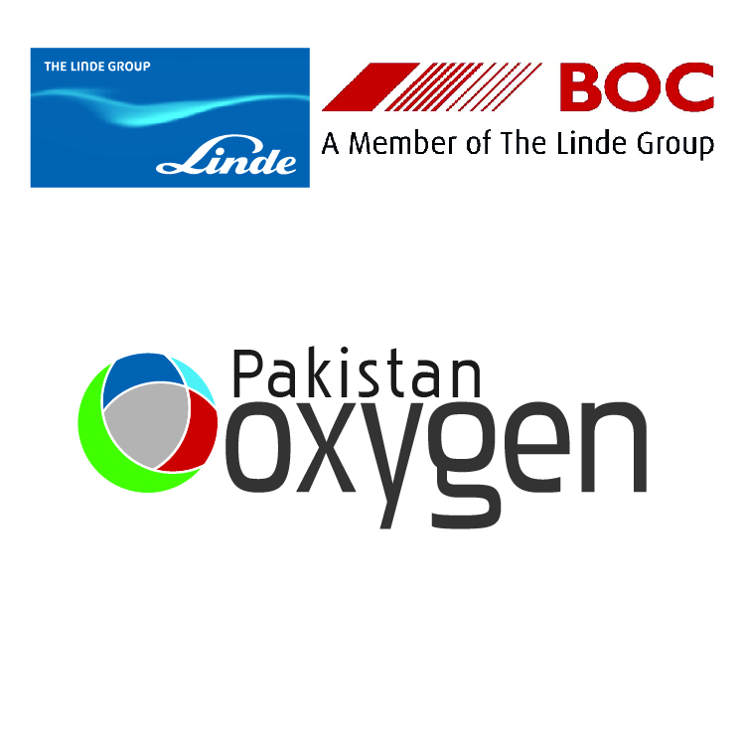
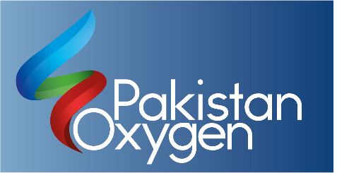
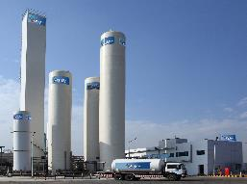
Rich and Strong Heritage
1935
Indian Oxygen and Acetylene Company
1949
Pakistan Oxygen & Acetylene Company (Pvt.) Limited
1957
1995
1997
2000
2004
2008
2009
2011
2012
2018
Pakistan Oxygen Limited
BOC Pakistan Limited
Strategic partner for Lotte PPTA, 100 TPD ASU at PQ
Strategic partner for PARCO, On-site GAN at QG, 30 TPD ASU at TXL
60 TPD CO2 at Multan
23 TPD CO2 at PQ
Nitrous Oxide Plant at LHR
Linde Pakistan Limited
133 TPD ASU at LHR
Pakistan Oxygen Limited

Slide 5



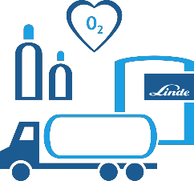
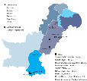


Company at a glance
4.8bn Sales
1.1bn GP
5-year CAGR 5.5%
149 permanent staff
200 third-party employees
1,500 customers across Pakistan
Leader in industrial medical gases
Leader in tier-1 welding & hardgoods
Largest geographic foot-print and customer outreach in gases industry
Highest priority to SHEQ
Aspiring for ISO 45001 certification

Slide 6


Slide 7
Our Board of Directors
Waqar A. Malik | Matin Amjad | Atif Riaz Bukhari | Fawad Anwar | Siraj A. Dadabhoy
Chairman | Chief Executive Officer | Director | Director | Director
S. Hasan Ali Bukhari | Sheikh M. Abdullah | Shahid M. Umerani | Feroz Rizvi | M. Zindah Moin Mohajir
Director | Director | Director | Director | Director
7

Slide 8
Our Business

Slide 9
Vision, Mission & Values
Vision
To improve the quality of life and wellbeing of people, communities and environment by operating in all sectors of the economy; envisage growth aggressively as a market leader while admiring its people.
Mission
To remain the market leader in industrial and medical sector while growing aggressively in welding & hardgoods. We shall achieve this profitably on sustained basis through the talent of our people, product reliability, superior product service & quality. We would provide innovative solutions to our customers along with enhancing trust of our shareholders while keeping highest standards of ethics, safety and environment.
Empowering
People
Innovating for Customers
Thriving through Diversity
Passion to Excel
OUR VALUES
Safety
OUR PRINCIPLES
Integrity
Sustainability
Respect

Slide 10
Our Business
Bulk
Gases supplied through large road tankers, delivered in storage tanks at customer sites
Tonnage
Gases supplied at customer sites by turnkey plants designed for specific customers
PGP
Compressed gases of industrial and specialty grade along with gas/ arc equipment & hardgoods for welding cutting
Healthcare
Medical grade gases along with associated services like designing and installation gas pipeline for hospitals

Slide 11
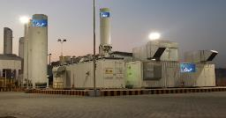
Profile and Leadership Position
Business Profile
4 Business areas – Tonnage, Bulk, PGP and Healthcare
Portfolio includes: Industrial & Special gases, Healthcare & Welding products
Catering to approximately 1500 customers spread across a variety of sectors
e.g. Healthcare, Manufacturing, Steel, Fabrication, Chemicals, Petrochemicals, F&B
Markets
Only company providing on-site ASU gases solution
Market Leader in bulk ASU gases and Tier-1 welding consumables
Largest provider of Medical Gases in the Healthcare sector in all major cities
Assets & Facilities
Three ASU plants with Pakistan’s largest installed capacity of about 263 TPD of Air Gases.
Two CO₂ plants with capacity to produce 83 TPD of product.
More than 260 Customer Tanks (VIEs) and large Delivery Vehicles
Hydrogen plant with capacity of 426 M3/hour
On-site Nitrogen plants 36 TPD
11

Slide 12




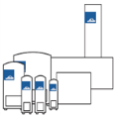



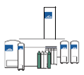

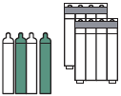

Integrated gases supply model
Tonnage
Or
On-site
Pipeline
Pipeline
Lotte PPTA
PARCO
On-site supply
Bulk
/HC
Transport of
liquefied gas
Shipbreakers
Steel Mills
Chemical
Fertilizers
Manufacturing
Large Hospitals
ASU
Cylinder
Filling sites
Filling sites
Retailer
Chemicals
Research
Fertilizers
Manufacturing
Small Hospitals

Slide 13
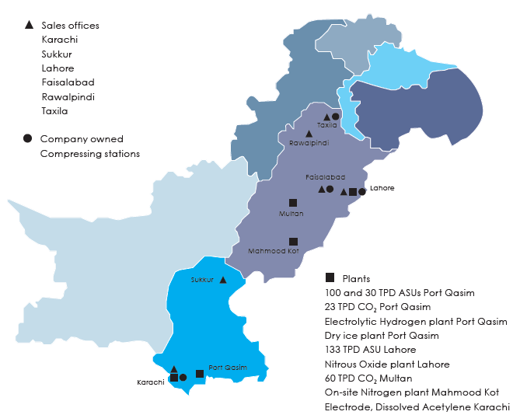
National Footprint
Geographical presence across Pakistan
Multiple Sales offices and sales depots to serve customers from South to North
13

Slide 14
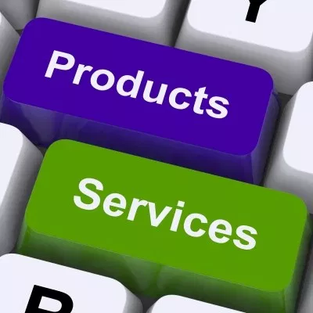

Slide 15
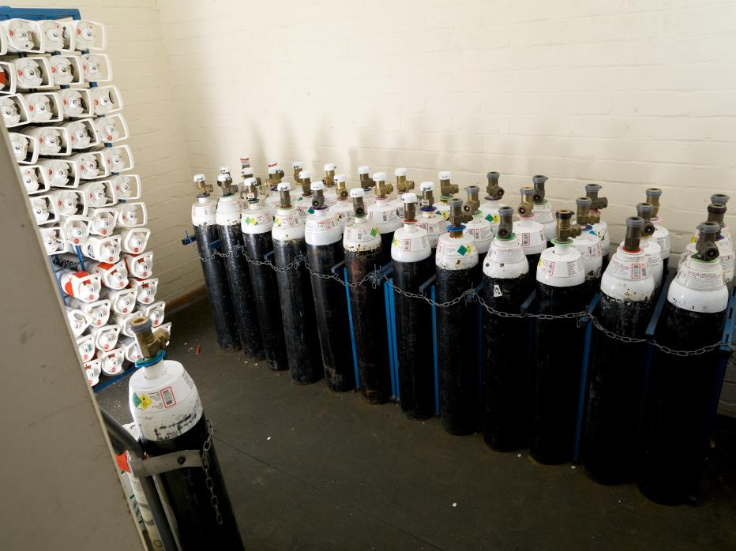
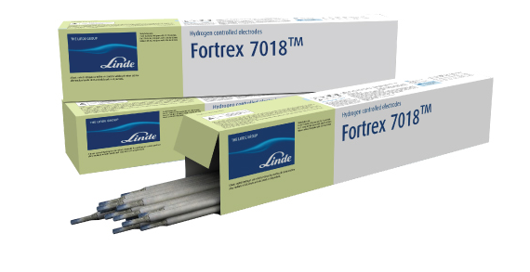
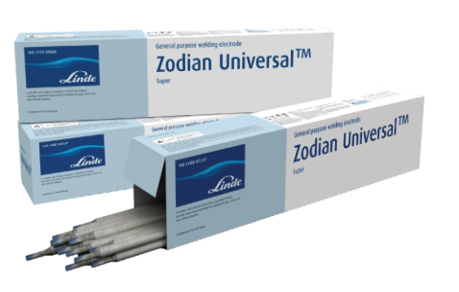
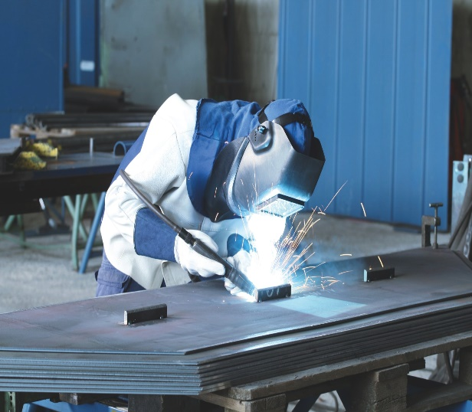
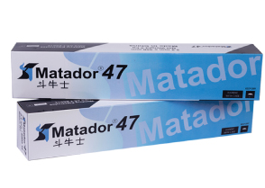
Products & Services
Medical
Other Gases
Medical Oxygen
Nitrous Oxide (N₂O)
Medical N2
Medical CO2
Entonox
Medical Pipeline
Acetylene
Helium
Propane
Carbon Dioxide
Hydrogen
Refrigerants
Industrial
Specialty Gases
Nitrogen
Oxygen
Argon
Food Grade CO2
Trailer Hydrogen
Pure Gases
Specialty Gas Mixtures
Hydrocarbon Mixtures
Calibration Mixtures
Hardgoods
Welding Electrodes
Welding Wire
Abrasives
Gas & Arc equipment
Calcium Carbide
15

Slide 16
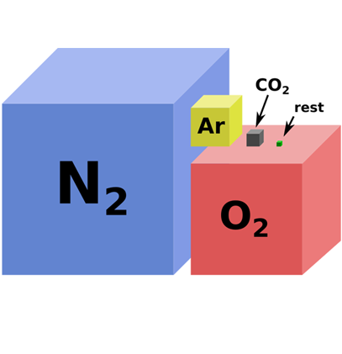
Bulk Business

Slide 17
Bulk Business
Product quality
We supply bulk gases like liquid oxygen, liquid argon, liquid nitrogen and liquid carbon dioxide to standard specifications. Product quality is continuously monitored online. Detailed testing is conducted on the product storage tank.
Supply & delivery
To ensure supply reliability and to ensure productivity, our preferred mode of delivery is to manage your inventory and schedule deliveries (via our scheduling system) on a 24/7 basis
Tanks & equipment
Our highly trained and expert engineering team (Customer Engineering Services – CES) will provide foundation design and specifications. Our Customer Engineering Team (CES) provides customized design, installation and maintenance services. We can fast-track installation and commissioning of your equipment if you are working to a tight timeline
Analysis and certification
We can provide you with Certificates of Conformance and Certificates of Analysis as well as customized certificates to meet your individual documentation needs for the purpose of quality management.
Bulk Gases
Liquid Nitrogen (LIN)
Liquid Oxygen (LOX)
Liquid Argon (LAR)
Liquid Carbon dioxide (LCO2)
Trailer Hydrogen
Services
17

Slide 18
Healthcare

Slide 19
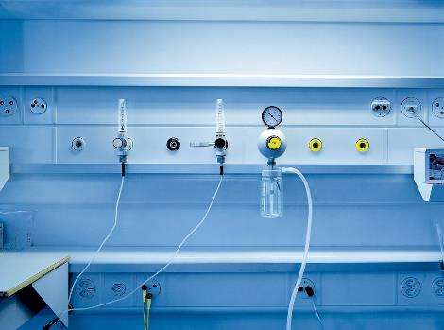
Healthcare
Ensuring Reliable Medical Oxygen Supply
Medical grade gases with Real Time O2 Level/Pressure Monitoring System

Slide 20


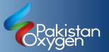
Complete Medical Pipeline and Engineering Services
From Gas storage to pipeline for point of use, we are supplying complete solutions
Design, sourcing, engineering and installation of Medical pipeline are done as per HTM standards
20

Slide 21
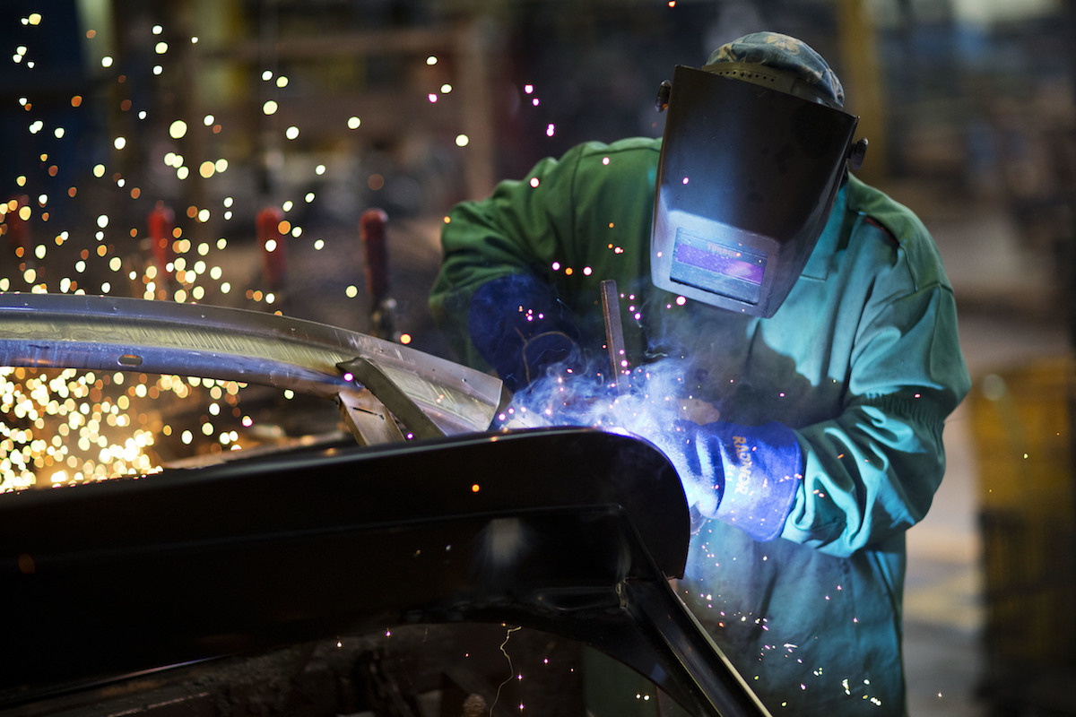
Welding & Hardgoods

Slide 22

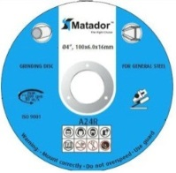
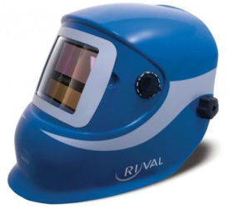
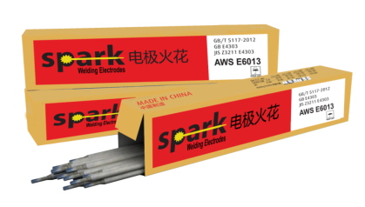
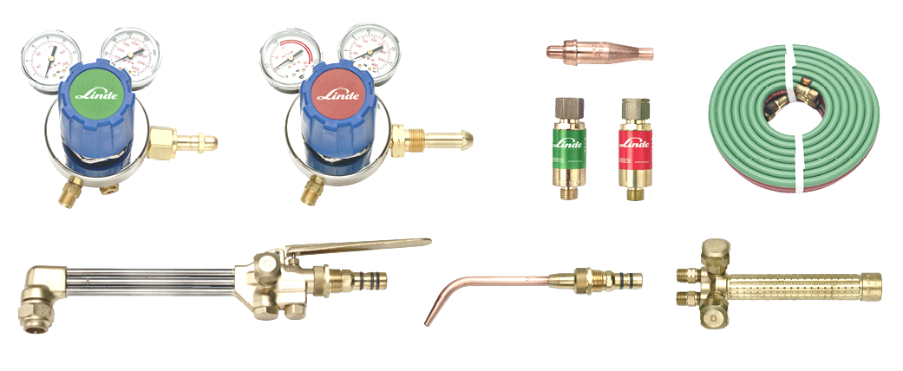
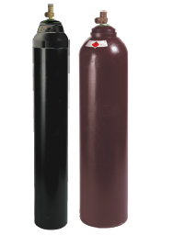
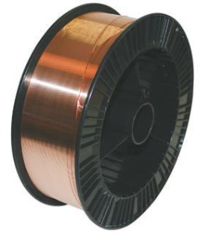
Complete Solution for Industrial Gases & Welding Hardgoods
22

Slide 23
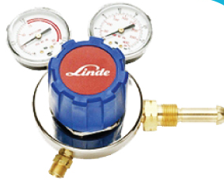
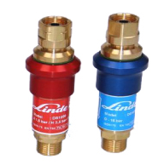
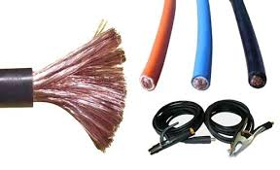

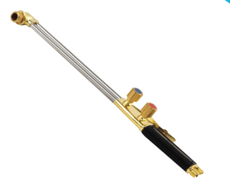

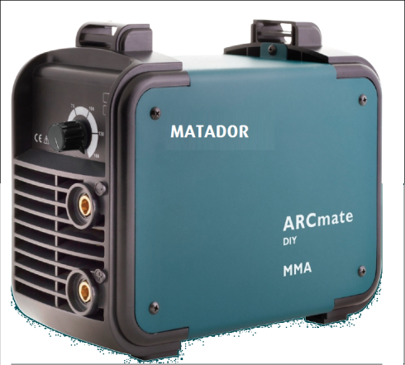
Gas & Arc Equipment / Accessories
Safety Auto-Darkening Helmet
Cutting & Grinding Disk
Electrode Holders
& Welding Cables
MMA & TIG Welding Machines
Gas Regulators
Flashback Arrestors
Cutting & Welding Torches
MIG Welding Wire
23

Slide 24
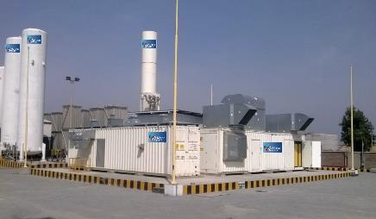
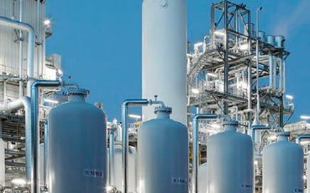
Tonnage
On-site Gas Solution
With more than 70 years’ heritage in the industrial gases and equipment market, our understanding of our customers’ requirements is unequalled.
This has allowed us to develop complete solutions, supplying high-quality industrial solutions as per safety standards across the country.
Our knowledge and capability makes us the ideal partner to provide our customers with products that meet the demands of their business.
For our customers with huge product demand based on their daily consumption flow rate, we can provide On-site solution by designing, commissioning and operating turn-key plants are our customer sites.
Our customers from Oil & Gas and chemical sectors rely on our Tonnage and Plant Engineering solution due to our strong legacy and our world-class quality and safety standards.

Slide 25


Slide 26
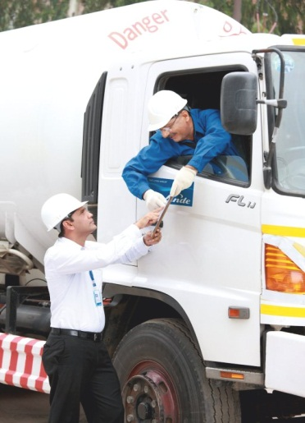
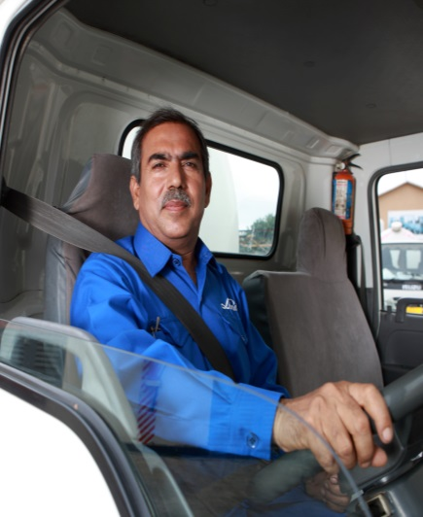
Safety, Health, Environment And Quality (SHEQ)
SHEQ has always been our topmost priority at Pakistan Oxygen as we aim to improve the quality of our products and services constantly, while maintaining the highest standards of safety, health, environment and quality.
We have implemented ’Golden rules of safety’ which apply across our company including our contractors with the aim of preventing severe injuries and fatalities and supporting the journey towards strong safety culture.
Visible Leadership is also a critical component of our SHEQ Strategy and Senior Management team, Function Heads, & managers – everyone support the SHEQ agenda through active engagement, interventions, positive renforcements etc., crucial for building an excellent safety culture.
Hazards and Risk Management regarding the storage of flammable, toxic, cryogenic materials & processes are already reviewed and mitigated at all of our production sites.
We also implemented best industry practices in Pakistan Oxygen including:
Competency Based Training and internal licensing
Monitoring of unsafe behaviors
Installation of telemetry systems at critical installations at customer sites
26

Slide 27
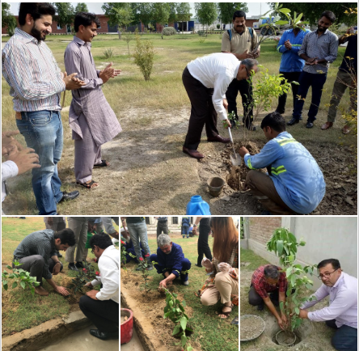
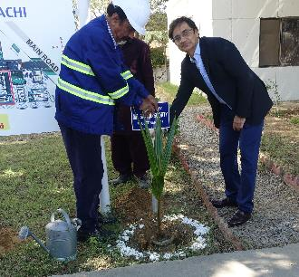
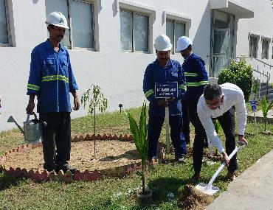
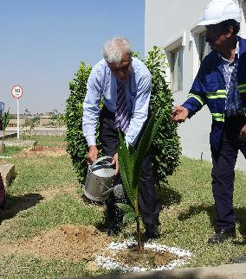
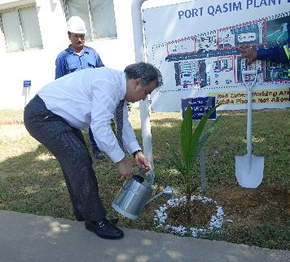
Environmental Campaign
#Oxygen-for-life
Tree Plantation Activities
As part of 14th Aug celebrations, plantation activities were conducted at various sites of Pakistan Oxygen, around 300 plants and trees were planted by the team as part of #Oxygenforlife campaign. Plantation was also conducted on this board meeting at PQ Plant by Board of Directors.

Slide 28
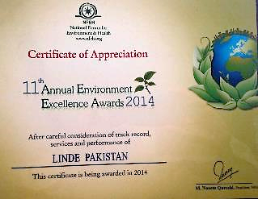
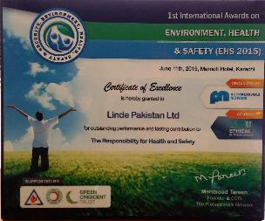
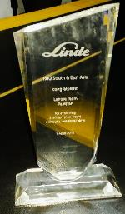
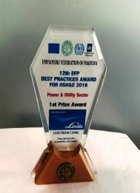
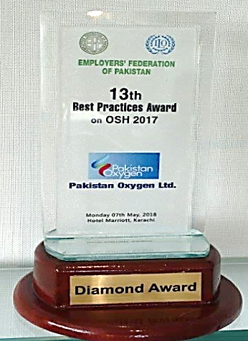
Awards & Recognitions
Linde RSE Award for Lahore Site for achieving 3 Million manhours without Lost time injury
Environmental Excellence Award by National Forum of Environment and Health
International Award on Environment and Health by Professional Network
Platinum Best Practices Award in HSE in 2016 by Employers Federation of Pakistan & International Labor Organization.
The Linde Business Excellence Awards for Safety Excellence
Diamond Best Practices Award in HSE in 2017 by Employers Federation of Pakistan & International Labor Organization
One of the first few companies in Pakistan to initiate ISO 45001 Safety Certification Process
28

Slide 29
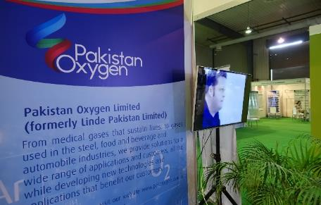
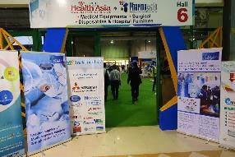
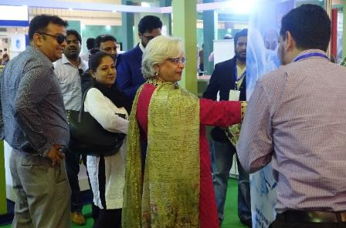



Brand Promotion Activities
15th Health Asia Exhibition and Conference
Key Highlights – 11th to 13th September 2018
Strengthened brand image and awareness. Exhibited our range of Products and Services. 500 guests visited the POL booths during the 3 day event with diversified backgrounds including doctors, medical staff, corporate professionals, students, academia and general public. Received product queries from potential customers. Mr. Mark Rakestraw, British Deputy Chief of Mission also visited the stall and showed high interest in company’s British and German history.

Slide 30

Financials

Slide 31
Achievements
Sales are 10% higher than last year
    Robust growth in sales of electrodes in PGP
    Incremental sales of Hydrogen driven by inclusion of new tube trailer
    Significant improvement in Oil & Gas sector performance
    Re-commencement of previously discontinued business of Calcium Carbide
ASU plants remained fully loaded, production increased by 0.6 million m3 compared to last year
Successful installation and commissioning of electrode factory
Successful installation and commissioning of compressing station at Sukkur
Uninterrupted & successful migration of SAP and IT infrastructure post Linde
Linde based systems/HR portals were successfully transferred to new applications developed in-house by IS

Slide 32
P&L versus Last Year (LY)
PKR- Million
SALES
GROSS PROFIT
FINANCE COST
+10%
+12%
+22%
OVERHEAD
OPERATING PROFIT
PROFIT AFTER TAX
-19%
+50%
+66%

Slide 33
Earning before Interest & Tax
PKR – Million
* Earning Before Interest & Tax
EBIT is higher by 50% compared to last year
Financial charges are higher by 22% compared to last year (higher interest rates and higher utilization of credit facilities )
EPS at Rs 15.92 is 66% higher than last year
33

Slide 34


